Slide 1
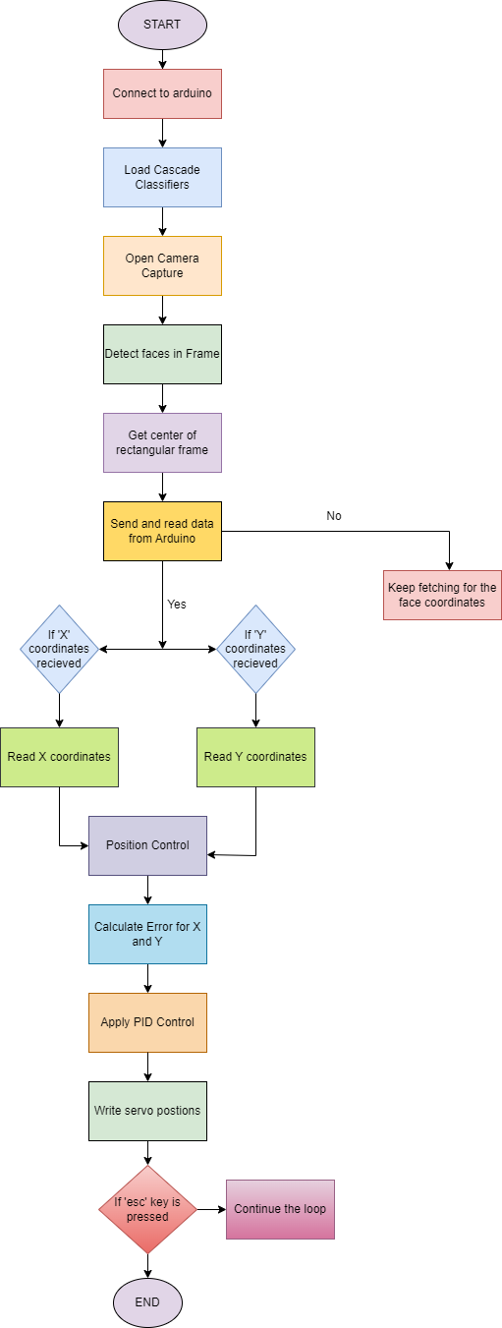
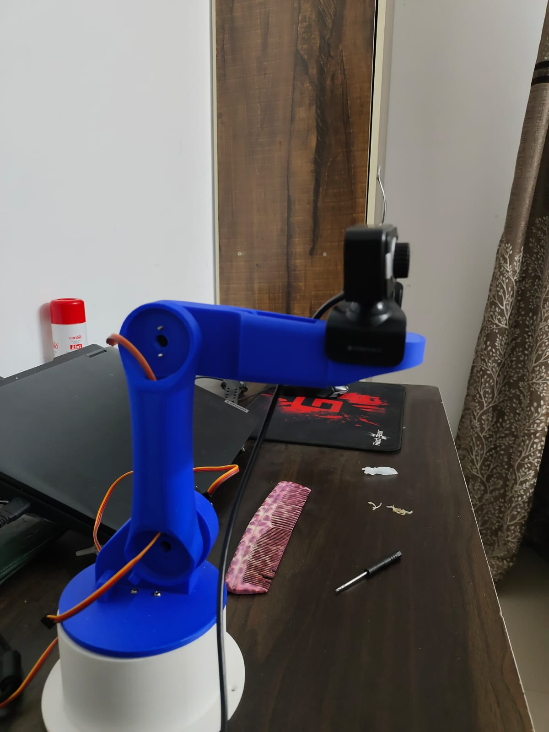
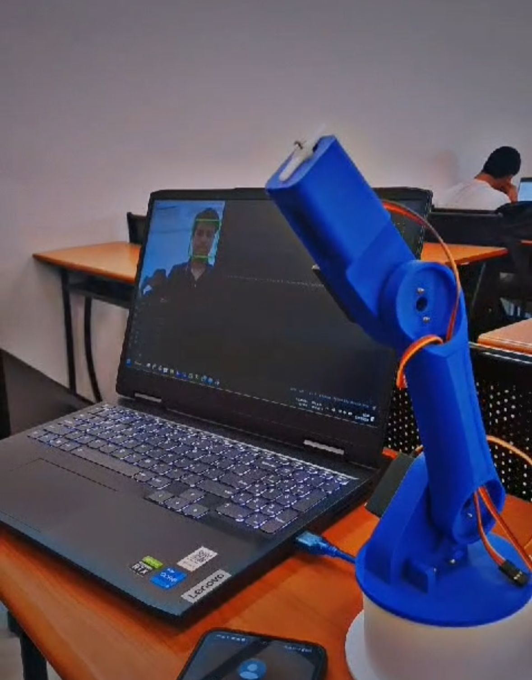
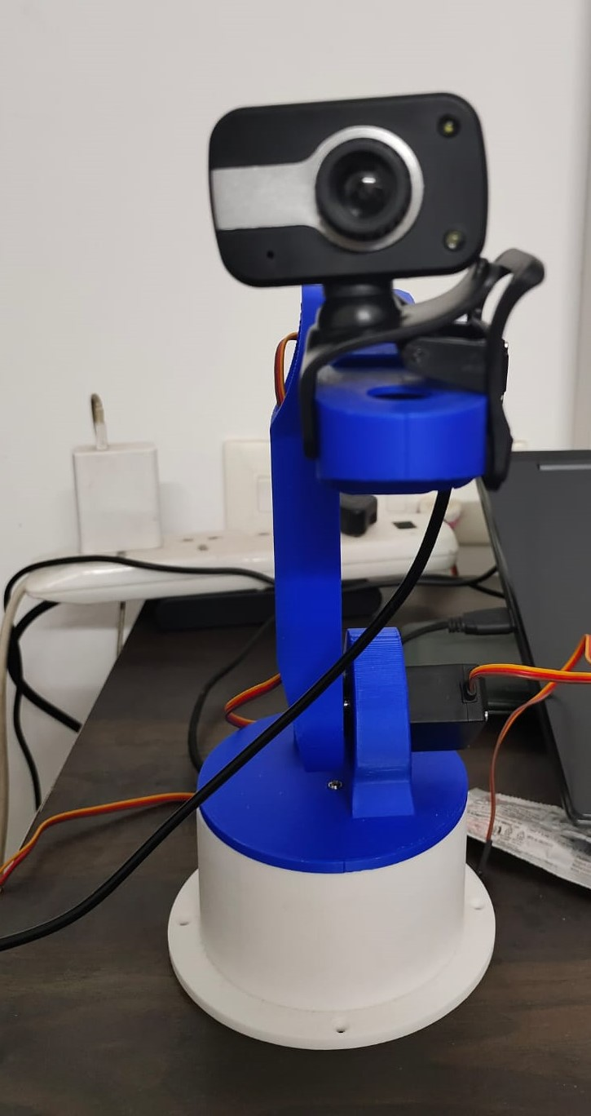
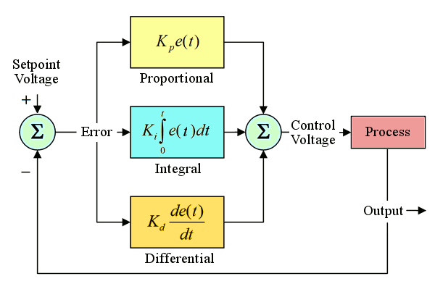
RCS KDR Mini Project– Batch 2022-26
Title of the project – Face Tracking Robotic Arm
INTRODUCTION:
In the ever-evolving landscape of robotics, the interaction between humans and machines stands as a cornerstone, driving innovation and progress forward. Our project, centered on a Facial Tracking Robot Arm, epitomizes this crucial interface, where intricate control systems seamlessly bridge the gap between human actions and robotic responses, for better control.
METHODOLOGY:
RESULTS :
The Facial Tracking Robot Arm project demonstrates successful implementation in accurately tracking facial movements.
System Initialization and face detection
Error Calculation & PID Control
Servo and loop termination
FLOWCHART
CONCLUSIONS:
The Facial Tracking Robot Arm exemplifies progress in human and robot interaction. Future efforts aim to refine tracking and broaden applications, from healthcare to personalized robotics, through ongoing collaboration and technological advancements.
OBJECTIVES & AIMS:
To create a real-time face tracking system utilizing computer vision algorithms for detecting and tracking faces within a video stream.
To incorporate a robotic arm governed by PID algorithms, autonomously adapting its position in response to detected face position and coordinates.
To implement a robust communication protocol between the computer and the Arduino microcontroller to transmit face coordinates efficiently.
Name of students:
Ansh Sharma (PRN: 22070127011)
Priyanshu Lathi (PRN: 22070127048)
Harmanaya Sharma (PRN: 22070127023)
Name of Guides:
Dr Javed Sayyad
Dr Ramesh B T
PID Working
Department of Robotics and Automation

